Slide 1

INFO6210 Data Management and Database Design
35889 Sec 06
Final Exam – Mini Project
Truck Transportation System
By
Venkata Lakshmi Mahitha, Mandalapu (001387807)

Slide 2
Truck Transportation Systems
PROBLEM STATEMENT:
Transportation of heavy goods need a systematic management system.
Need timely status of the delivery.
Need easy approach to the customer to check available Trucks and choose the type of Truck.
APPROACH/SOLUTION:
A Structure SQL Database(Logistics) is designed to maintain all the data
Entity-Relationship Diagram(ERD) is drawn showing all the entities and attributes present in the database.
Business Rules are clearly Frames
All the tables in database are created.
Data is inserted into the tables.
Many operations are performed on the Database to show the easy access of data.
Different users with different privileges are created.
A Backup strategy is defined.

Slide 3
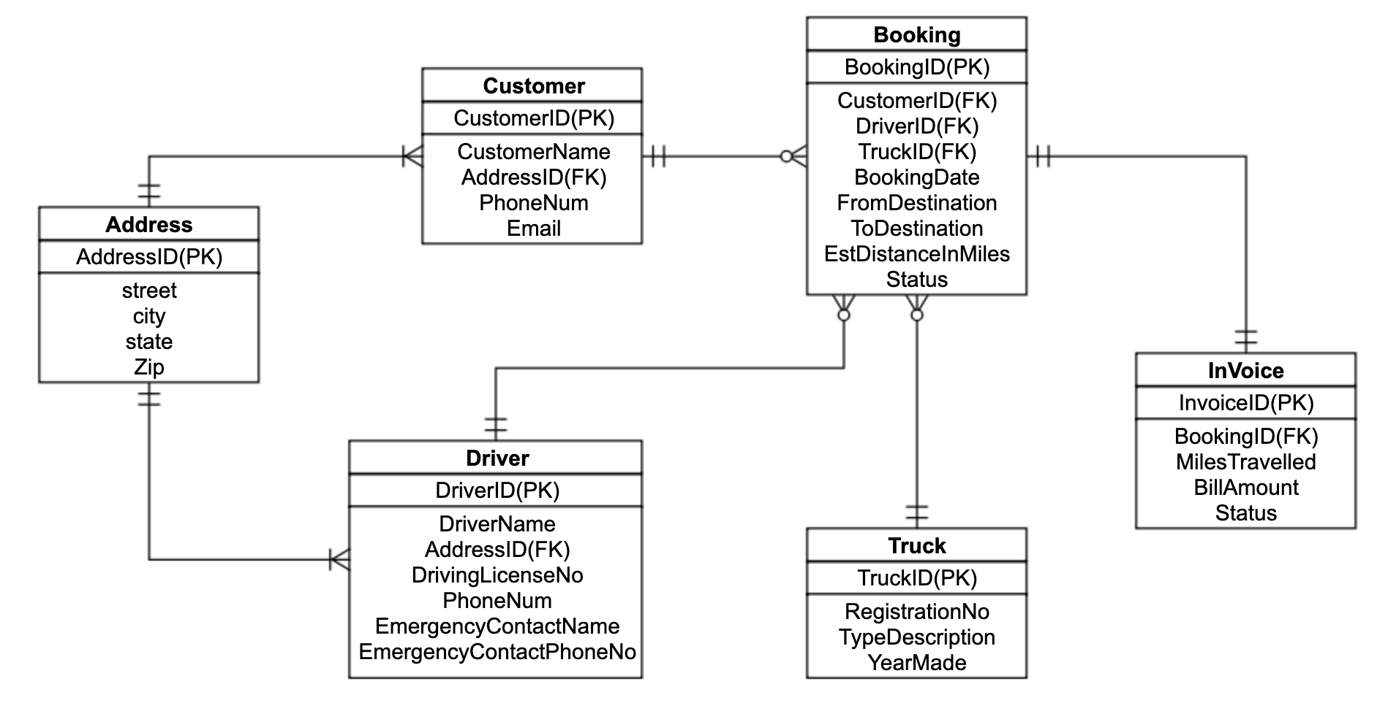
Logistics – ER Diagram

Slide 4
Business Rules
A Customer or a Driver can have only one Address but an Address can belong to one or more Customers or Drivers.
A Customer may book many Bookings but each Booking must be booked by only one Customer.
A Driver may be assigned many bookings but for each booking has only one driver.
A booking is assigned only one Truck but a truck may be assigned to many bookings.
For each booking an invoice is generated and an invoice belongs to only one booking.

Slide 5
Set 1 & Set2

Slide 6
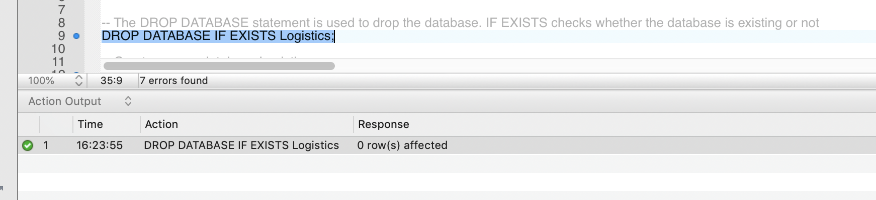
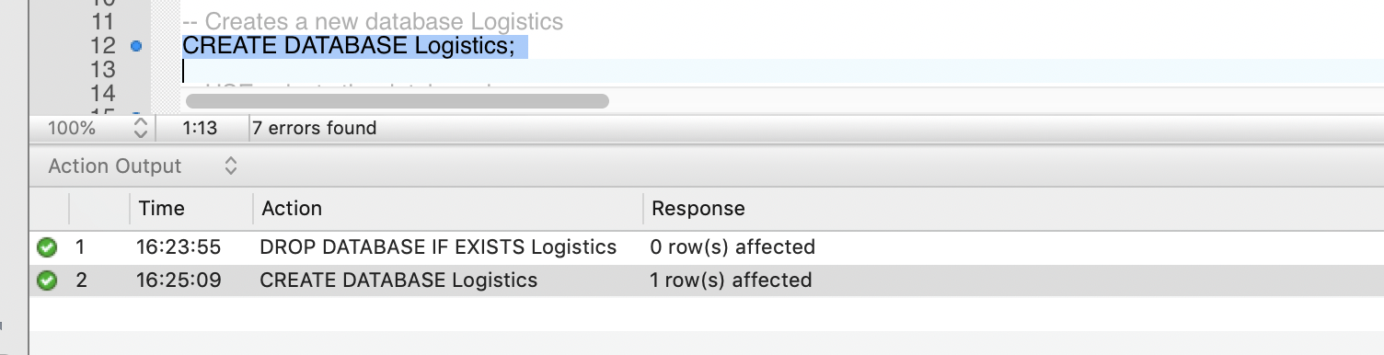
Create Database
The CREATE DATABASE statement is used to create a new SQL database.
The DROP DATABASE statement is used to drop an existing SQL database.

Slide 7
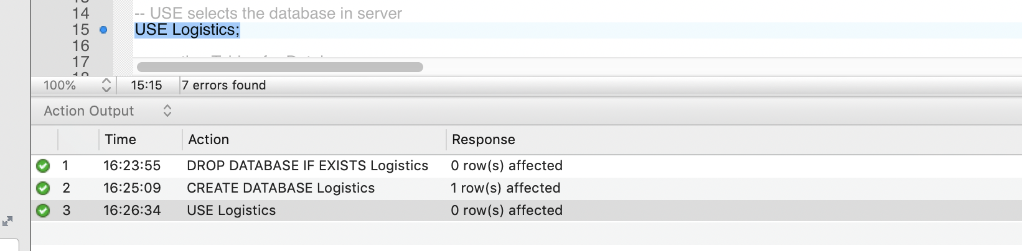
Create Database
The USE statement is used to select a database.

Slide 8
Create Tables
The CREATE TABLE statement is used to create a new table in a database.
SYNTAX:
CREATE TABLE table_name ( column1 datatype constraint, column2 datatype, column3 datatype, .... );
The datatype parameter specifies the type of data the column can hold (e.g. varchar, integer, date, etc.).
We can also add constraints while creating tables.
Constraints are used to limit the type of data that can go into a table. This ensures the accuracy and reliability of the data in the table. If there is any violation between the constraint and the data action, the action is aborted.

Slide 9
Create Tables
The following constraints are commonly used in SQL:
NOT NULL - Ensures that a column cannot have a NULL value
UNIQUE - Ensures that all values in a column are different
PRIMARY KEY - A combination of a NOT NULL and UNIQUE. Uniquely identifies each row in a table
FOREIGN KEY - Uniquely identifies a row/record in another table
CHECK - Ensures that all values in a column satisfies a specific condition
DEFAULT - Sets a default value for a column when no value is specified
Also we can use certain keywords to specify some characteristics
Auto-increment allows a unique number to be generated automatically when a new record is inserted into a table.
The following tables are created in Logistics database using all the above techniques:

Slide 10
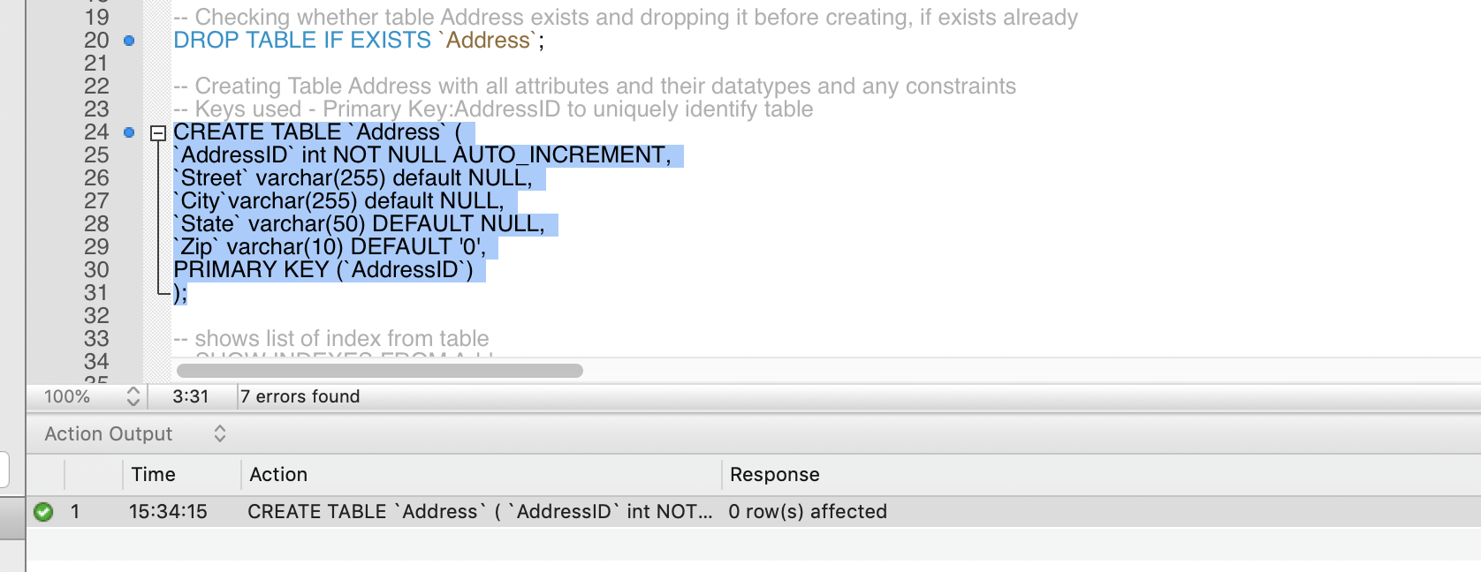
Create Tables
Here Address table is created with the shown columns.
AddressID is a primary key which is unique and is given constraint NOT NULL and AUTO_INCREMENT.
The remaining columns are given default values.
All the columns are specified with data type.
The DROP TABLE statement is used to drop an existing table in a database.

Slide 11
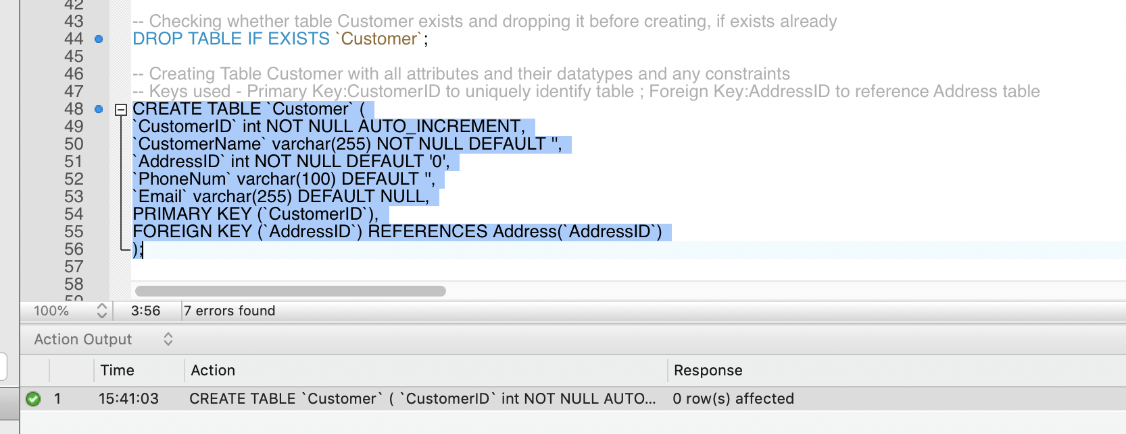
Create Tables
Here Foreign Key constraint key is mentioned and AddressID of Address table is referred to the AddressID of Customer table.

Slide 12
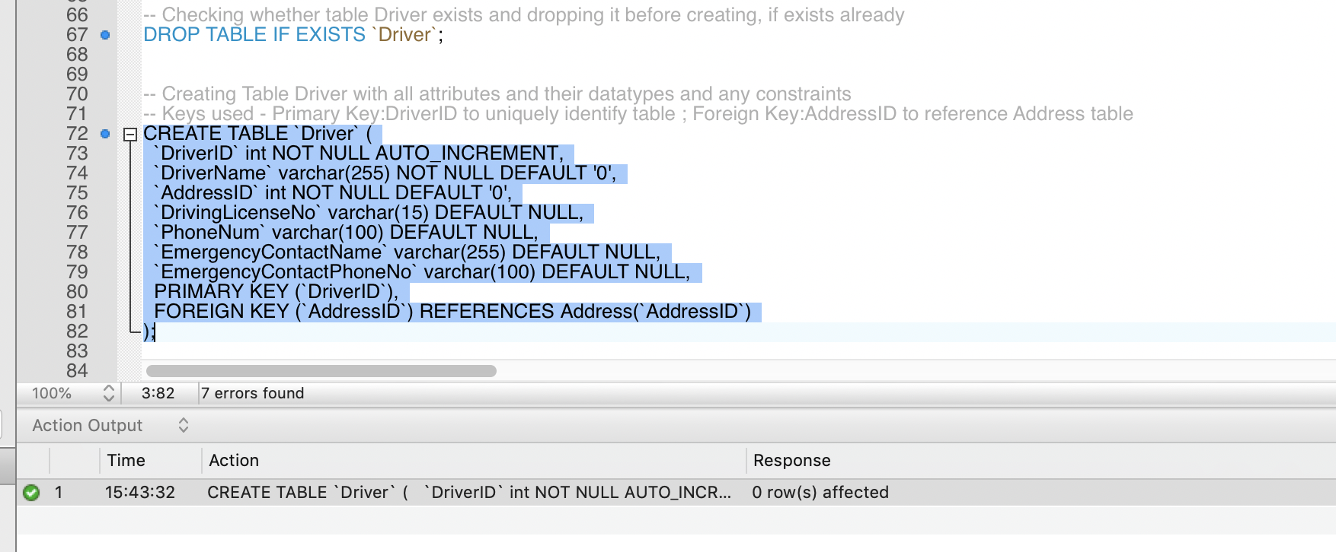
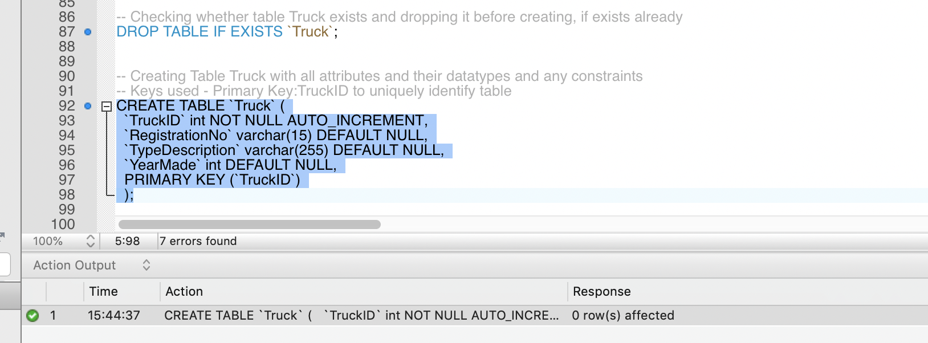
Create Tables

Slide 13
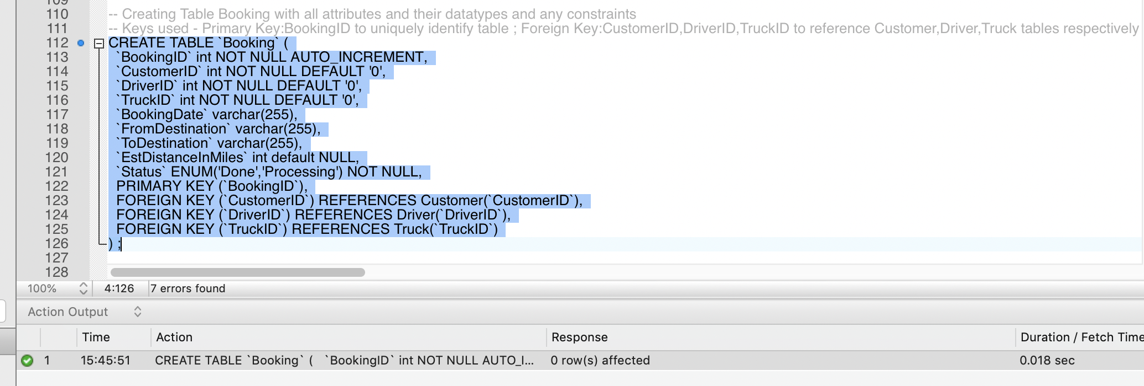
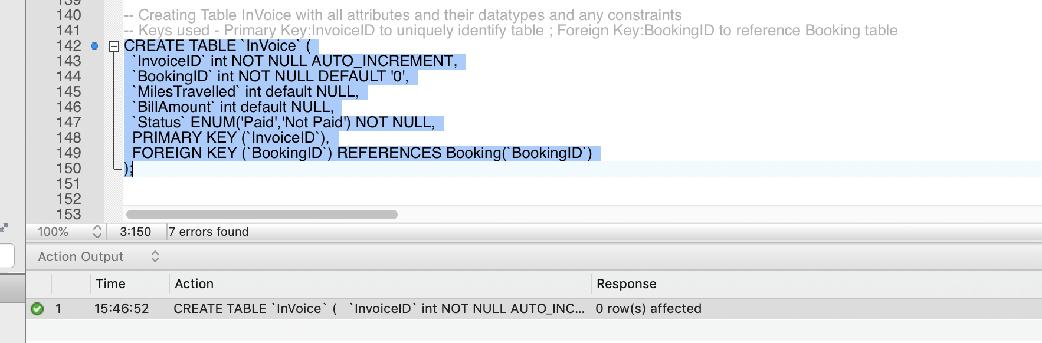
Create Tables

Slide 14
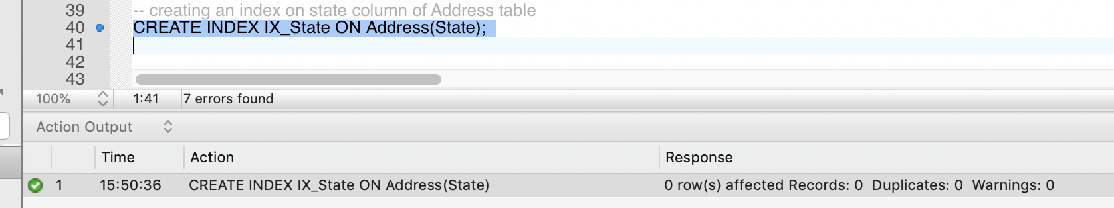
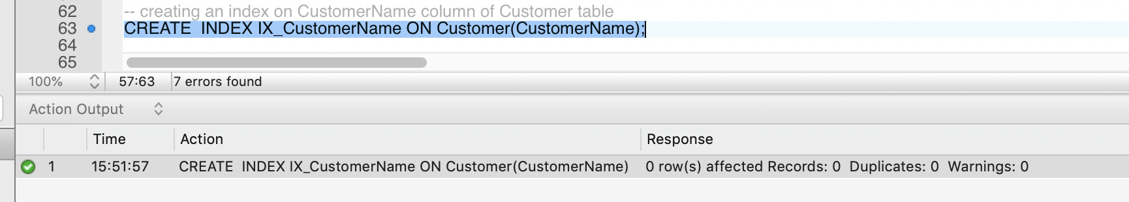
Create Tables - Index
The CREATE INDEX statement is used to create indexes in tables.
We can create index on a single column or multiple columns in a table.
The following indexes are mentioned in Logistics database.

Slide 15
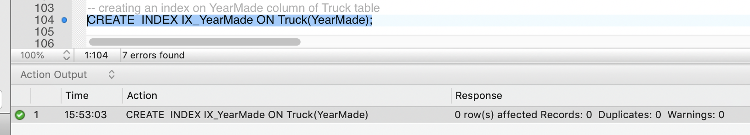
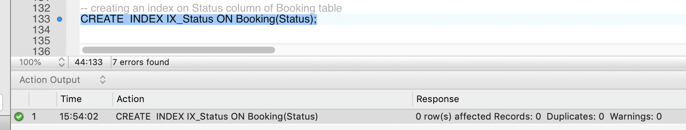
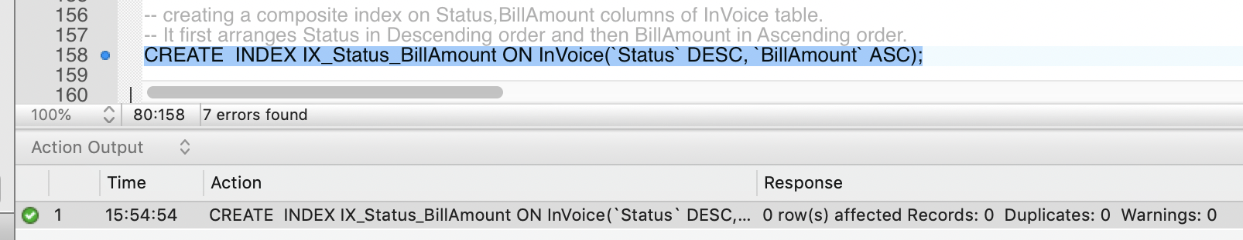
Create Tables - Index

Slide 16
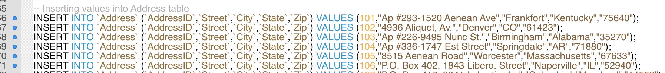
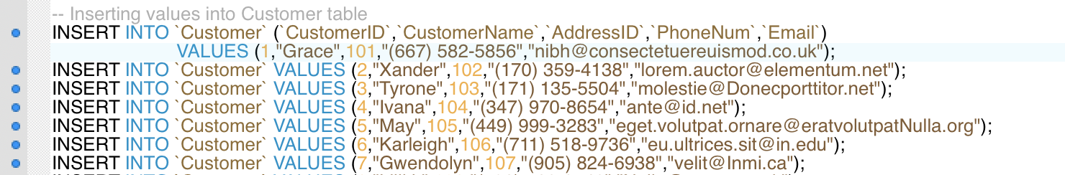
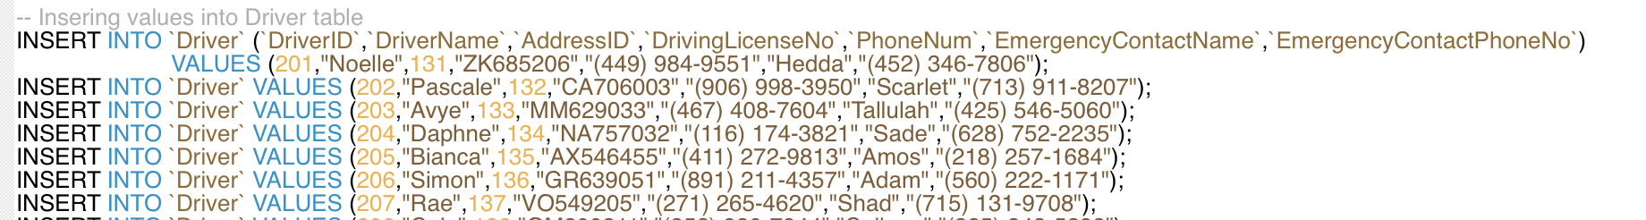
Insert Data into Tables
The INSERT INTO statement is used to insert new records in a table.
The following are insert queries used to insert data into tables of Logistics Database.
A sample of rows for each table are shown:

Slide 17
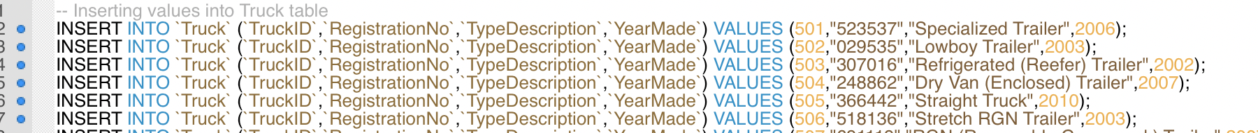
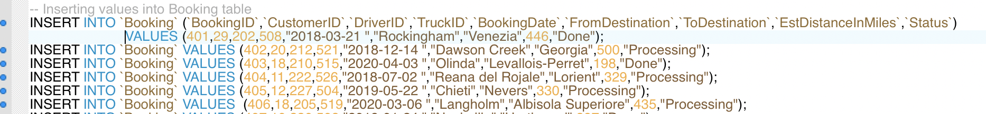
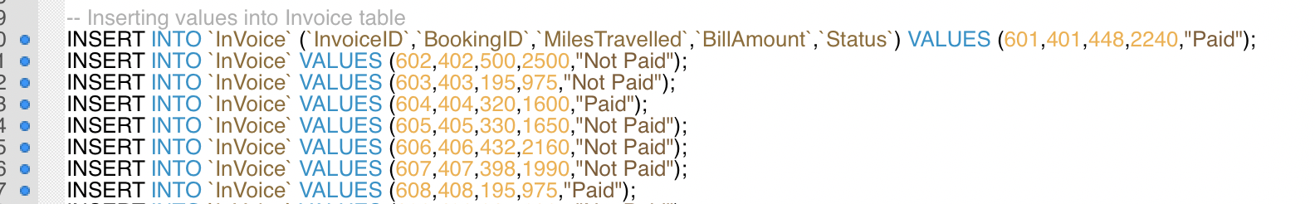
Insert Data into Tables

Slide 18
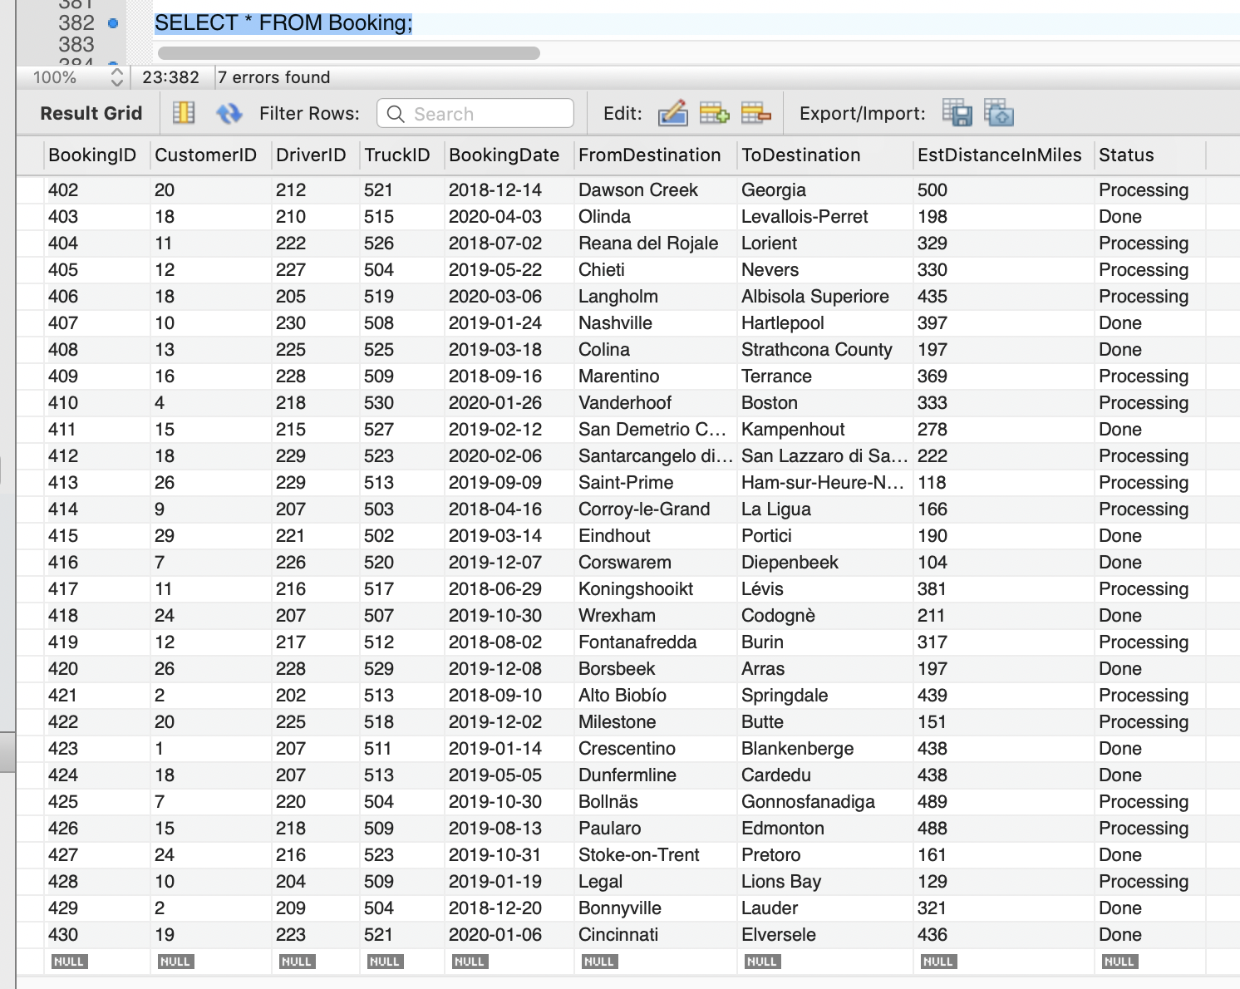
View Data in Tables
To view all the data of a table, we can use select query
SYNTAX:
Select * from table_name;

Slide 19
Set 3

Slide 20
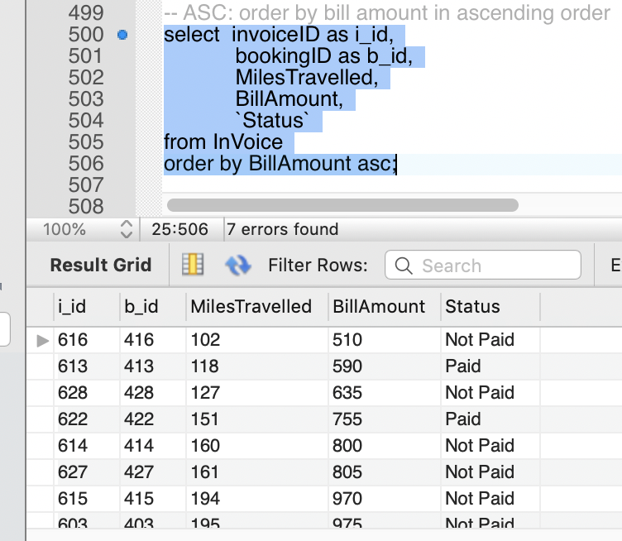
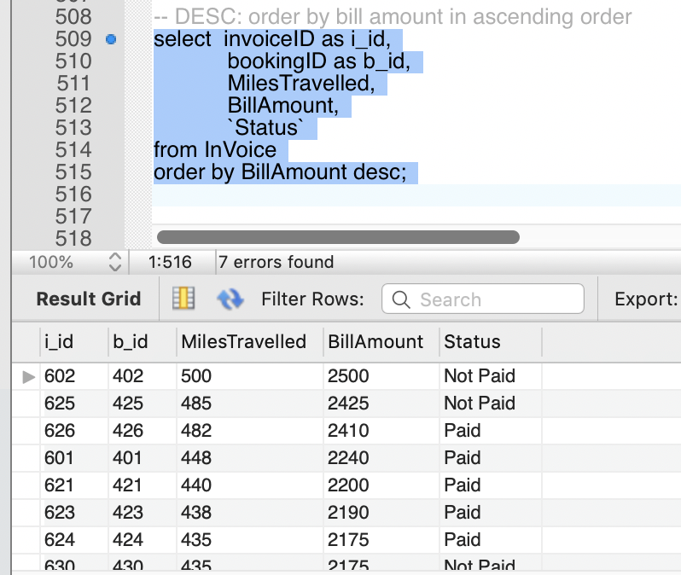
Select – From – Where – Group By – Having - Order By – Limit
ORDER BY:
The ORDER BY keyword is used to sort the result-set in ascending or descending order.
Here the BillAmount in Invoice table is sorted using order by

Slide 21
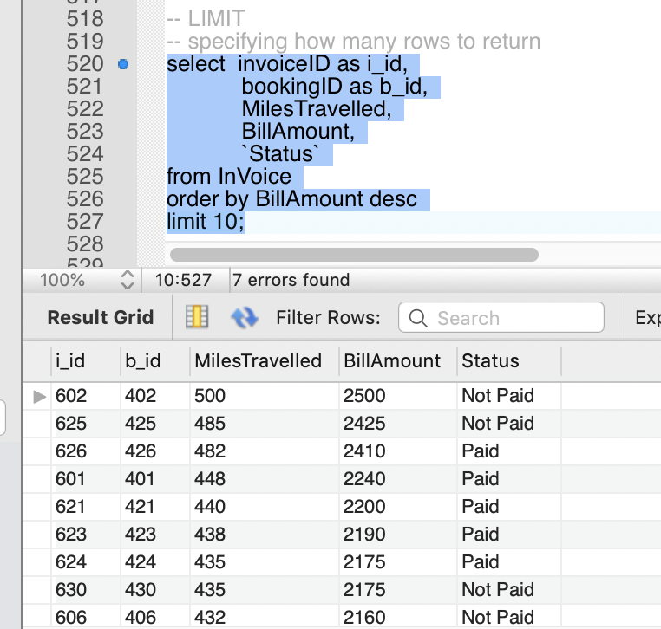
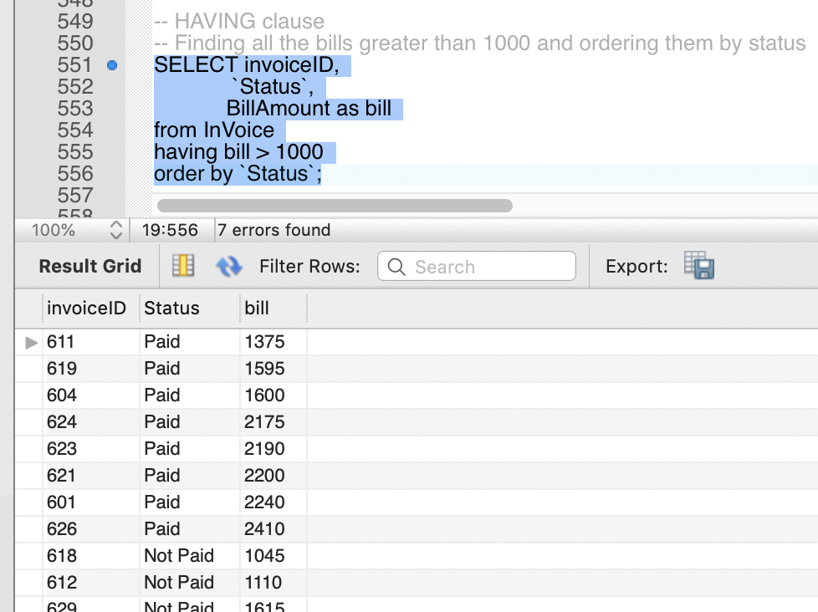
Select – From – Where – Group By – Having - Order By – Limit
LIMIT:
The LIMIT clause is used to specify the number of records to return.
Here only 10 rows if BillAmount in Invoice table are returned using LIMIT.
HAVING:
Having clause is similar to where but having can be used with aggregate functions.
Here having is used to find all the bills greater than 1000 from InVoice table.

Slide 22
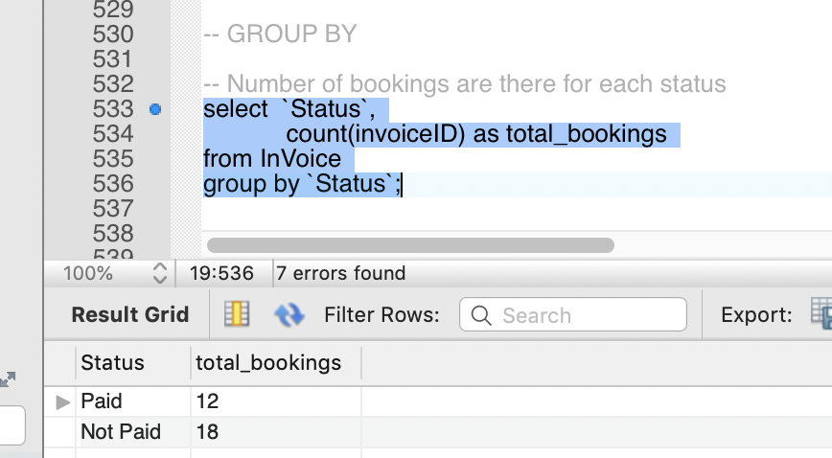
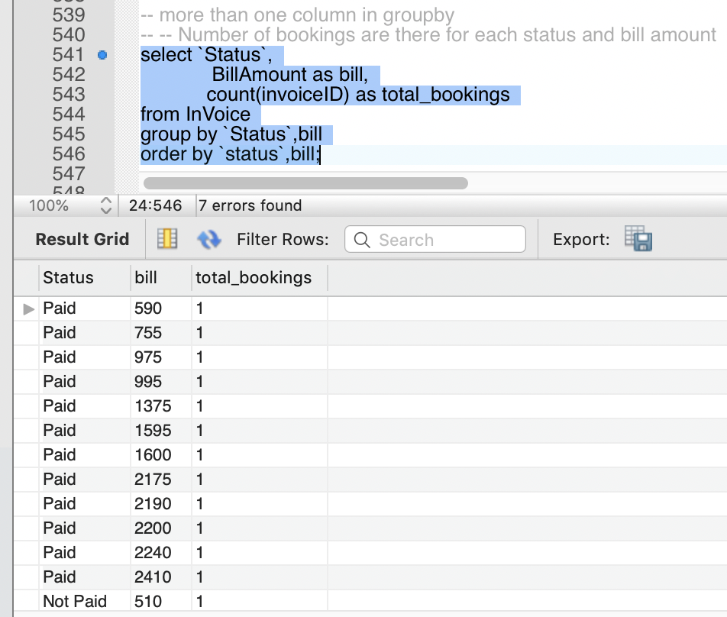
Select – From – Where – Group By – Having - Order By – Limit
The GROUP BY statement is often used with aggregate functions (COUNT, MAX, MIN, SUM, AVG) to group the result-set by one or more columns.
It can be used with one column or more than one column.

Slide 23
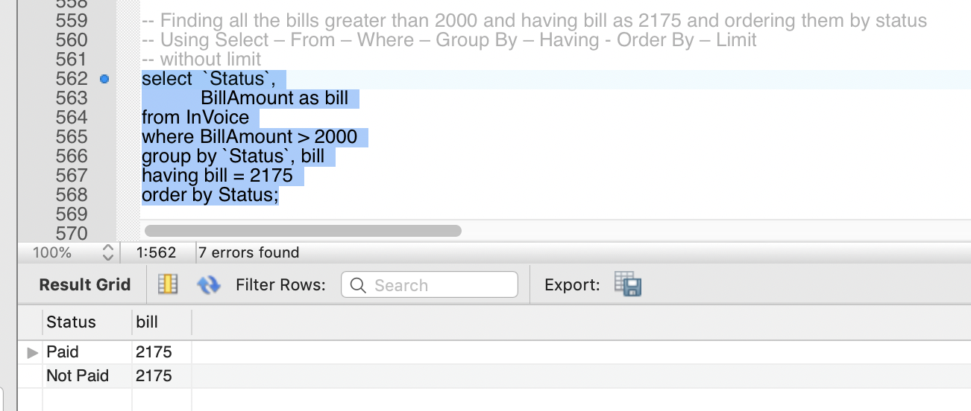
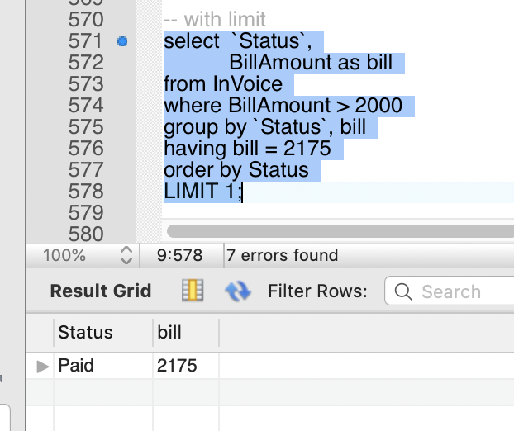
Select – From – Where – Group By – Having - Order By – Limit
All Group By, Having, Order By clauses can be used together in one single query.
The below are shown two examples for finding bills greater than 2000 and having bill as 2175 and ordering them by status
Without Using limit and using limit.

Slide 24
Set 4

Slide 25
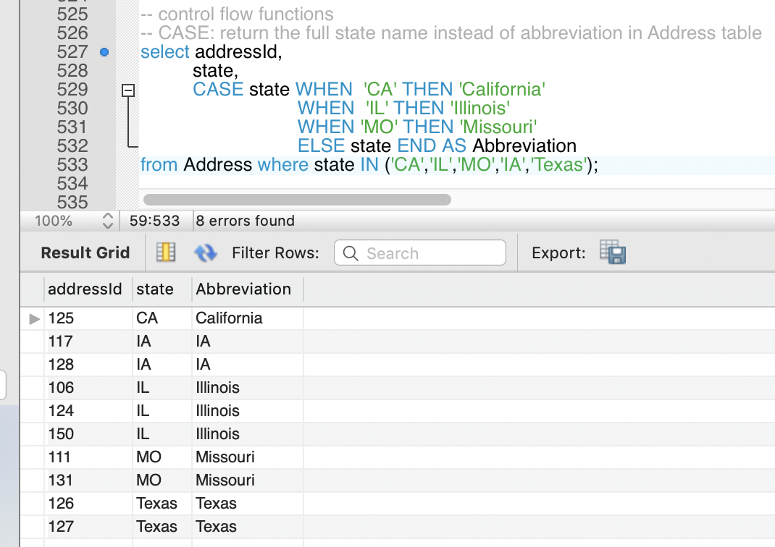
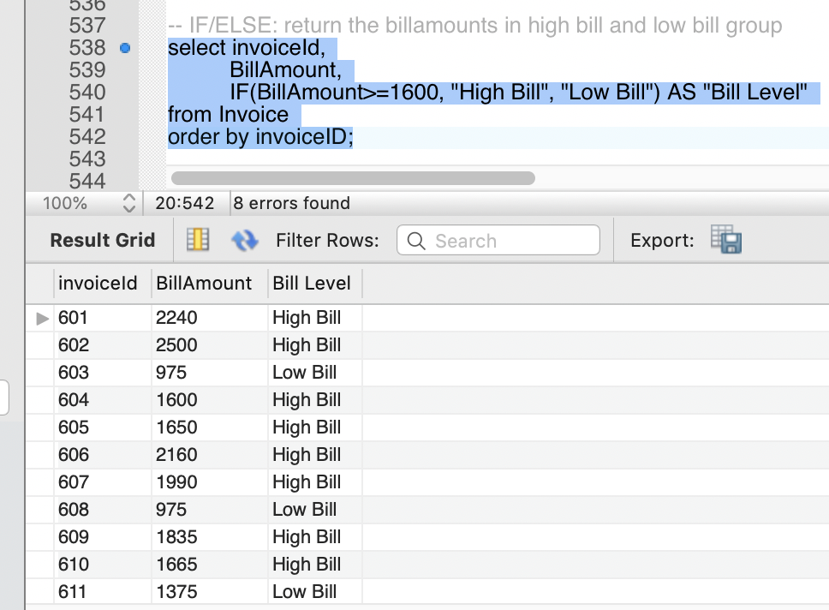
Control Flow Functions
Control Flow functions return a value for each row processed.
There are four Control Flow functions in MySQL - CASE operator, IF/ELSE construct, IFNULL, and NULLIF.
In Logistics database, we have used of these functions
CASE – to return the full state name instead of abbreviation in Address table, and
IF/ELSE – to return the billamounts in high bill and low bill group

Slide 26
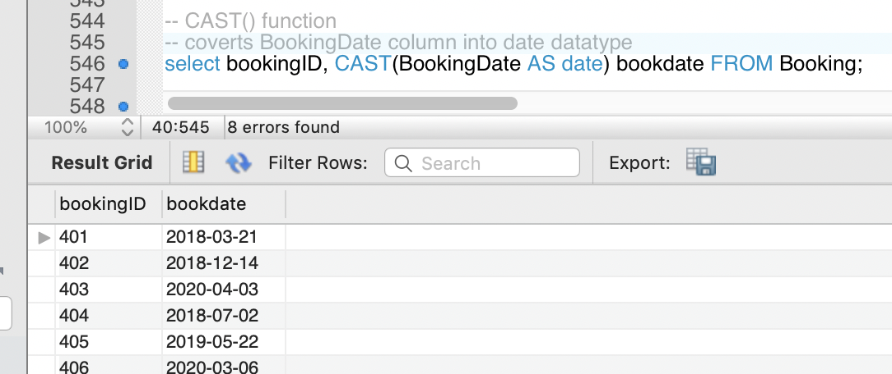
Cast Functions
The CAST function in SQL converts data from one data type to another
In Logistics database, we have used cast function in booking table to convert bookingdate from varchar type to date type.

Slide 27
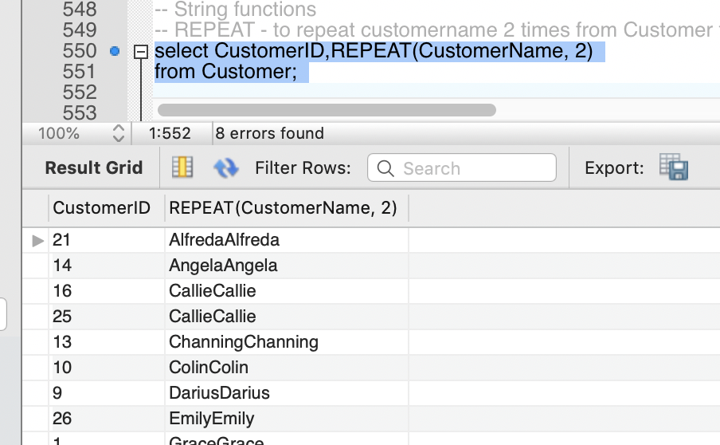
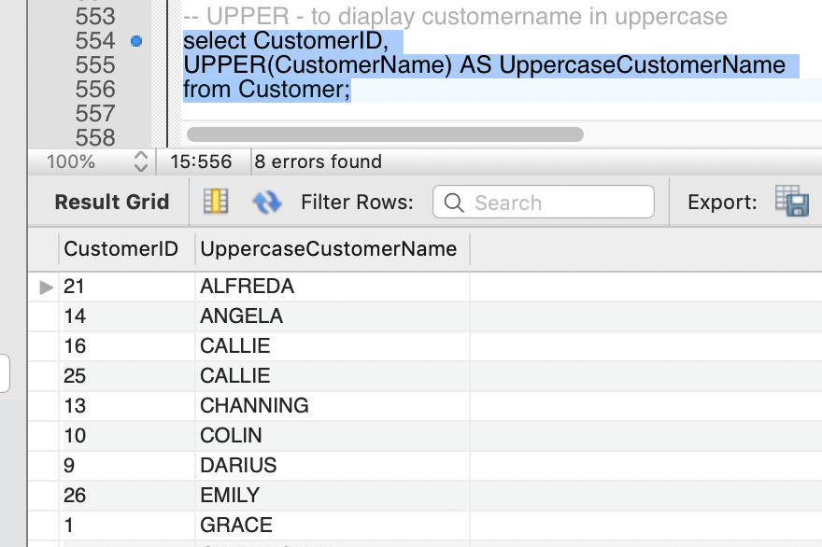
String Functions
In SQL, there are many string functions like SUBSTRING, REPLACE, TRIM, STRCMP, UPPER, UCASE, REVERSE,SPACE etc.
In Logistics database, REPEAT and UPPER functions are used.

Slide 28
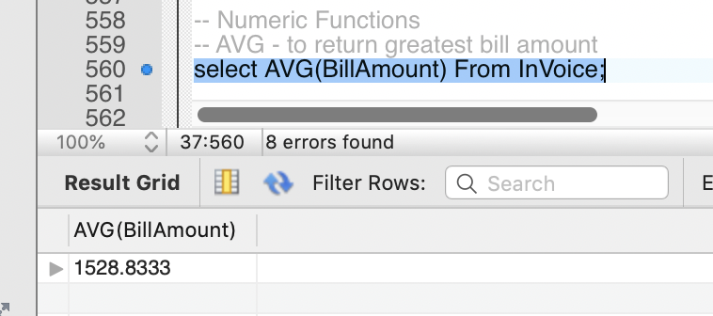
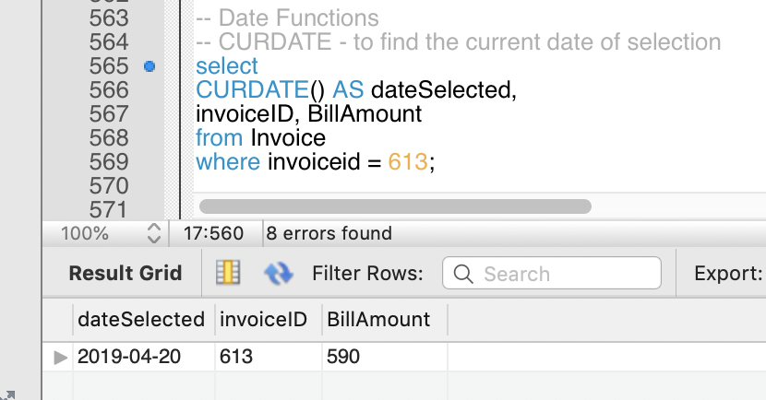
Numeric Functions
In SQL, there are many numeric functions like Greatest, Least, Ceiling, Floor, Mod, Power, Sum, Avg etc.
In Logistics database, Avg function is used.
Date Functions
There are many date functions in sql like NOW, CURDATE,CURTIME,DATE,EXTRACT etc.
In Logistics Database CURDATE is used.

Slide 29
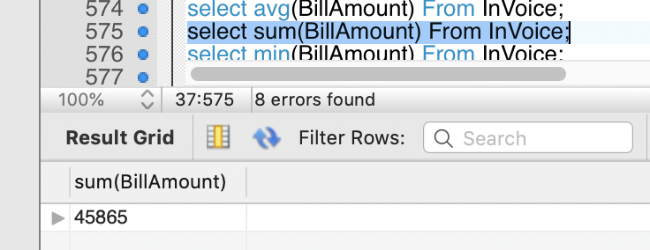
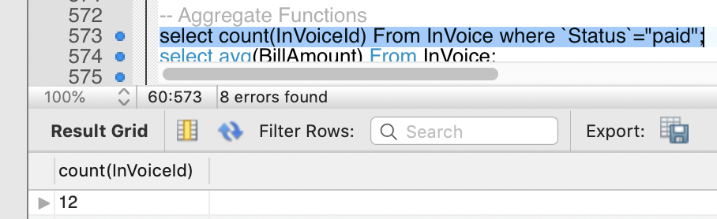
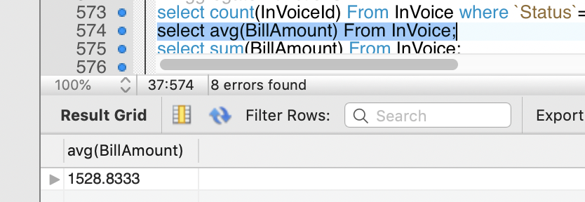
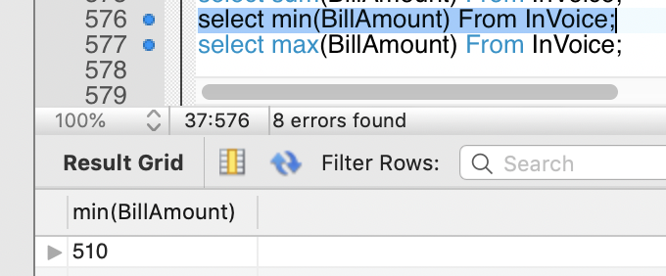
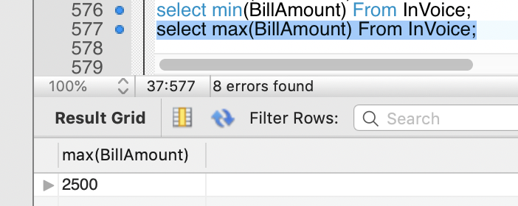
Aggregate Functions
The following are the most commonly used SQL aggregate functions:
AVG - calculates the average of a set of values.
COUNT - counts rows in a specified table or view.
MIN - gets the minimum value in a set of values.
MAX - gets the maximum value in a set of values.
SUM - calculates the sum of values.
In Logistics database, they are used as follows:

Slide 30
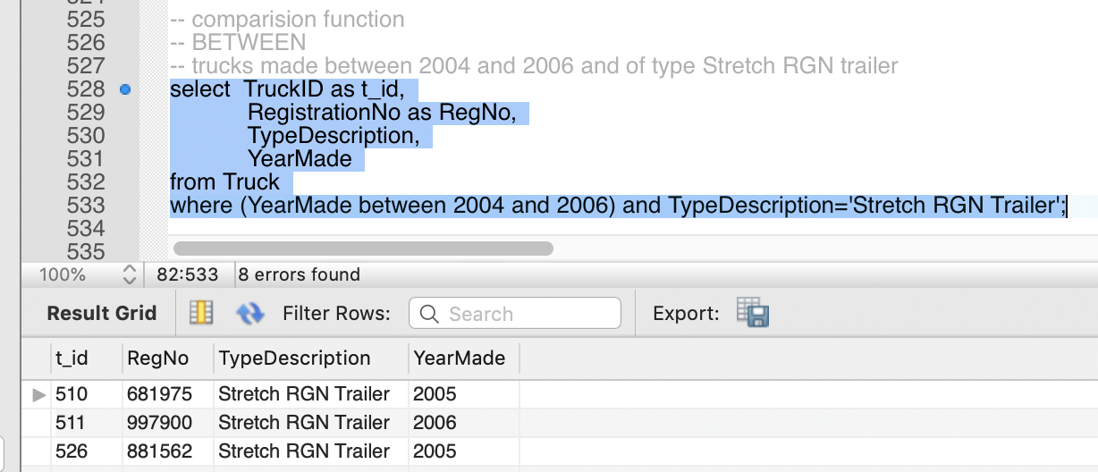
Comparison
For Comparison in sql, we use certain comparision operators like
BETWEEN: The BETWEEN operator selects values within a given range,
LIKE: is used to search for a specified pattern in a column. We can use % or _ to specify pattern,
IN: to specify multiple values in a WHERE clause,
ANY: returns true if any of the subquery values meet the condition
Some of the function operators used in Logistics database is as follows:

Slide 31
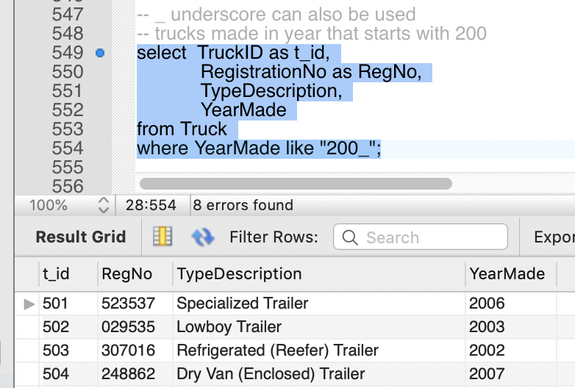
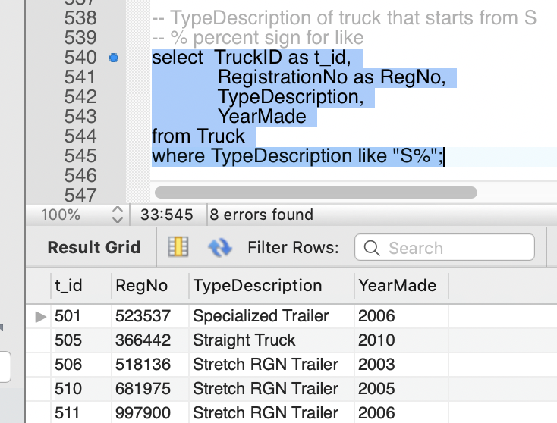
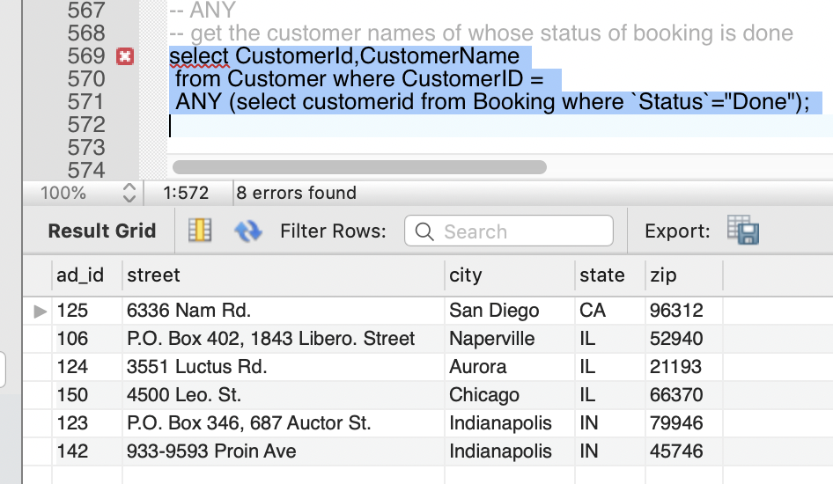
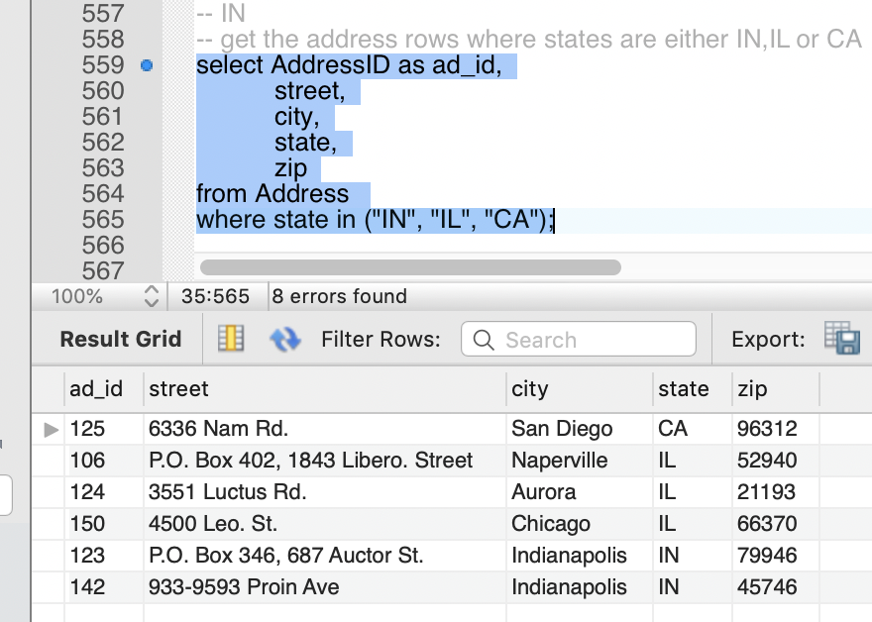
Comparison

Slide 32
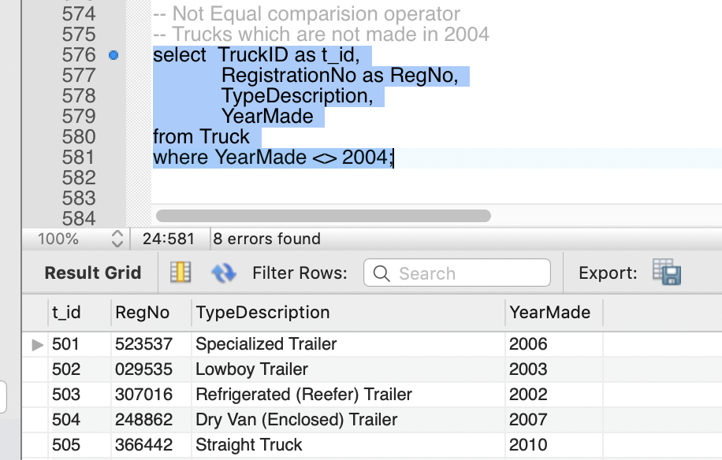
Comparison
Also there many comparision operators like
= Equal to, < = > Null-safe equal to, > greater than, >= greater than or equal to, < less than, <= less than or equal to, <> Not equal to, != not equal to

Slide 33
Set 5

Slide 34
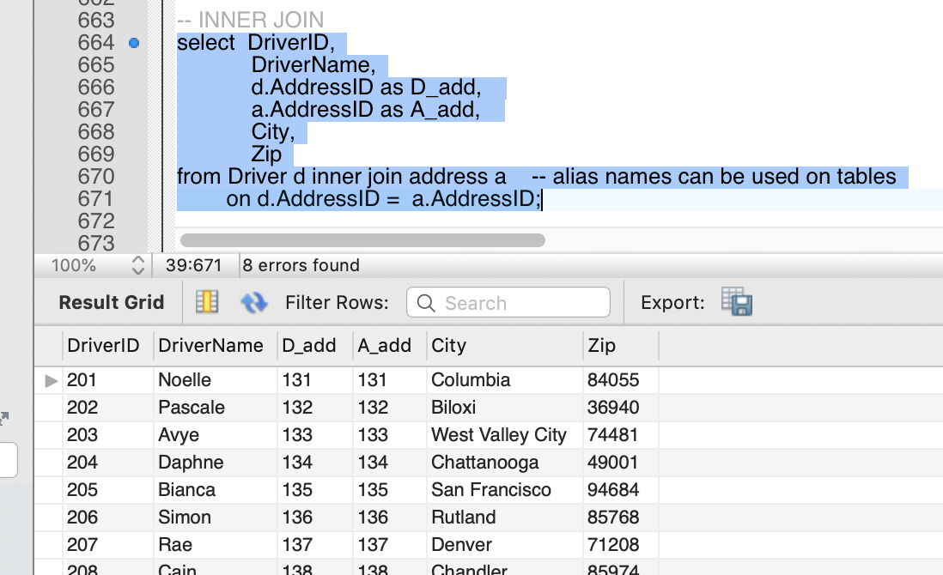
Joins
A JOIN clause is used to combine rows from two or more tables, based on a related column between them.
The INNER JOIN keyword selects records that have matching values in both tables.
The LEFT JOIN keyword returns all records from the left table , and the matched records from the right table. The result is NULL from the right side, if there is no match.
The RIGHT JOIN keyword returns all records from the right table, and the matched records from the left table. The result is NULL from the left side, when there is no match.
The FULL OUTER JOIN keyword return all records when there is a match in either left or right table records.
The CROSS JOIN produces a result set which is the number of rows in the first table multiplied by the number of rows in the second table if no WHERE clause is used along with CROSS JOIN.
In Logistics Database all the joins are used as follows:

Slide 35
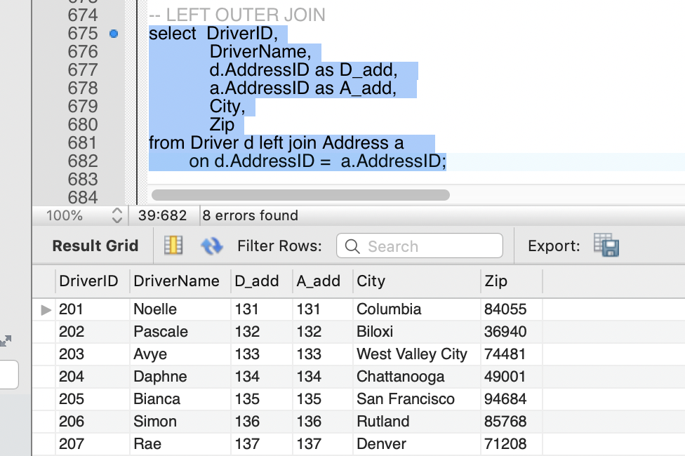



Joins
Full Join is not supported in mysql

Slide 36


Some operations on Logistics Database using Joins

Slide 37
Set 6

Slide 38

Queries and SubQueries
A subquery is a query within another query. The outer query is called as main query and inner query is called as subquery.
Some of the queries and subqueries used in Logistics database are as follows:

Slide 39



Queries and SubQueries

Slide 40
Set 7

Slide 41

Privileges
Four Different users are created in Logistics Database and different priviliges are given to them.
LogisticsAdmin: Has access on all the Logistics database.
LogisticsDeveloper: Has all developer rights i.e to insert, select, update and delete on Logistics database.
LogisticsTester: Has access for testing purpose to select and update on Logistics database.
LogisticsUser: User is given access to only select booking and invoice tables in logistics.
SQL coding given is provided as below:

Slide 42


Privileges

Slide 43


Privileges
We can also remove the privileges from the user using REVOKE statement as shown:

Slide 44

Privileges
When logged in as admin he has all the rights as shown below:

Slide 45

Privileges
When logged in as developer he doesn’t have right to drop as shown below:

Slide 46

Privileges
When logged in as tester he doesn’t have right to insert as shown below:

Slide 47

Privileges
When logged in as user he doesn’t have right to select on customer table as shown below:

Slide 48
Set 8

Slide 49

Stored Procedures
A stored procedure is a prepared SQL code that you can save, so the code can be reused over and over again.
The following stored procedures are used in Logistics Database:
This Procedure is used to find number of bookings with input as status value

Slide 50


Stored Procedures
This Procedure is used to find truck details given truck id as input and returns an error message if wrong input is given

Slide 51

Stored Procedures
This Procedure returns customer state as output given customer id as input

Slide 52
Set 9

Slide 53

Transactions
LOCK TABLES explicitly acquires table locks for the current client session.
UNLOCK TABLES explicitly releases any table locks held by the current session.
In the above example, Truck table in Logistics Database is locked for Read Privilege.
No other action can be performed on Truck other than select. Also no other action on any other table in Logistics can be done until UNLOCK TABLES is done

Slide 54

Transactions
A COMMIT statement in SQL ends a transaction within a database. It is used to permanently save any transaction into the database.
In mysql database, there is an automatic commit. So, in the below example the autocommit is explicitly set to off to show the action of commit.
We can see the new value is inserted correctly into the database.

Slide 55


Transactions
SAVEPOINT command is used to temporarily save a transaction so that you can rollback to that point whenever required.
RIOLLBACK command restores the database to last commited state. It is also used with SAVEPOINT command to jump to a savepoint in an ongoing transaction

Slide 56



Transactions
It is shown in the example that the value of YearMade is restored to the values as how they are at the mentioned savepoint

Slide 57
Set 10

Slide 58


Triggers
A trigger is a stored procedure in database which automatically invokes whenever a special event in the database occurs.
The following triggers are used in the Logistics Database:
This is a Trigger for invoice_backup table in which values are inserted when any row is deleted from invoice
It shows the data is inserted into invoice_backup when a record is deleted in InVoice.

Slide 59


Triggers
This is a Trigger for customer_log table in which values are inserted when any row is updated from customer.
It shows the data is inserted into customer_log when a record is updated in Customer.

Slide 60


Triggers
This is a Trigger for est_bill table in which values are inserted when any row is inserted in Booking.
It shows the data is inserted into est_bill when a record is inserted in Booking.

Slide 61
Set 11

Slide 62

Views
A view is a virtual table based on the result-set of an SQL statement.
The following views are created in Logistics database.
This view collects the invoice details for which the bill amount is above the average value.

Slide 63

Views
This view list the top five customers who make highest bill amounts.

Slide 64

Views
This view finds the error in estimated distance in miles from Booking table and Invoice table.

Slide 65
Backup Plan
The following assumptions are made for the backup plan:
A Full Backup(FB) takes around 10 hours and an Incremental Backup(IB) takes around 1 hour.
Thought the transportation happens day and night, all the bookings and invoice generations are done during daytime, the Peak hours of a day are 8AM to 10PM for weekdays and 10AM to 6PM for weekends.
Hence the non-peak hours and nimber of hours left for every day in a week are tabulated as below
Night | Off-Peak Start | Off-Peak End | Off-Peak hours
Monday | 10 PM | 8 AM | 10
Tuesday | 10 PM | 8 AM | 10
Wednesday | 10 PM | 8 AM | 10
Thursday | 10 PM | 8 AM | 10
Friday | 10 PM | 10 AM | 12
Saturday | 6 PM | 10 AM | 16
Sunday | 6 PM | 8 AM | 14
A Full backup is taken on Sunday and on remaining days incremental backup is taken. And all the backups are taken on night.
A 30-day sample with the proposed plan is shown in the next slide.

Slide 66
Backup Plan
Date | Day | Backup Type
April 1 | Saturday | FB
April 2 | Sunday | IB from last satday
April 3 | Monday | IB from last satday
April 4 | Tuesday | IB from last satday
April 5 | Wednesday | IB from last satday
April 6 | Thursday | IB from last wedday
April 7 | Friday | IB from last wedday
April 8 | Saturday | FB
April 9 | Sunday | IB from last satday
April 10 | Monday | IB from last satday
April 11 | Tuesday | IB from last satday
April 12 | Wednesday | IB from last satday
April 13 | Thursday | IB from last wedday
April 14 | Friday | IB from last wedday
April 15 | Saturday | FB
Date | Day | Backup Type
April 16 | Sunday | IB from last satday
April 17 | Monday | IB from last satday
April 18 | Tuesday | IB from last satday
April 19 | Wednesday | IB from last satday
April 20 | Thursday | IB from last wedday
April 21 | Friday | IB from last wedday
April 22 | Saturday | FB
April 23 | Sunday | IB from last satday
April 24 | Monday | IB from last satday
April 25 | Tuesday | IB from last satday
April 26 | Wednesday | IB from last satday
April 27 | Thursday | IB from last wedday
April 28 | Friday | IB from last wedday
April 29 | Saturday | FB
April 30 | Sunday | IB from last satday

Slide 67
References
For Sql coding:
https://www.w3schools.com/sql/
Lab Sql Files
Class Lecture Slides
For inserting data into the database:
https://www.generatedata.com/

